Slide 1

Insanity in Tennessee

Slide 2
What could have caused “Death by Insanity”?
From 1846 to 1915 there were 20 individuals (mostly male) who seemed to have passed from “insanity”. This leads me to believe that “insanity” could be related to PTSD. The dates and ages with which these individuals had passed correlate to dates during times of warfare and general unrest.
During these years there were several wars and slavery was at its peak. To give an example, Mr.Lowe, who was alive during the War of 1812, could have been a veteran. The term “insanity” was most likely used to describe symptoms of PTSD, as the term and illness was not identified until 1915 with the name “Shell Shock”. Another example is , William BrownLowe, who was a black male in the early 1800s and most likely a victim of slavery.
This idea can be carried into the later years as the ages of the people who died from “insanity” can be correlated with the age of soldiers at the time.

Slide 3
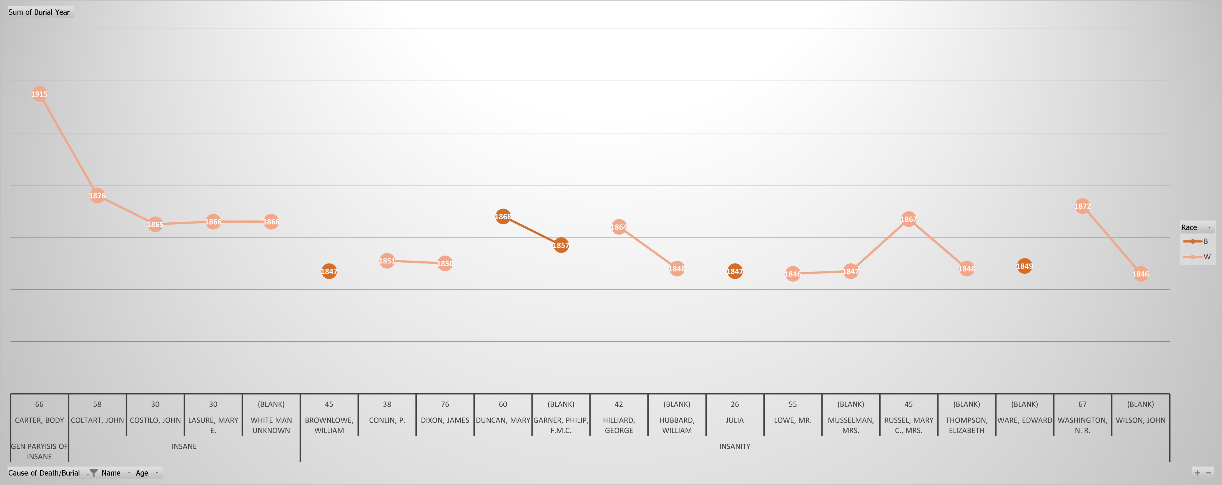
Slavery (Approx. 1760-1864) -War of 1812 (1812-1815)- Mexican War (1846-1848)- Civil War (1861-1865) -Spanish-American War (1898-1902)- Indian Wars (Approx. 1817-1898)

Slide 4
If you are interested in learning more about the history of the Nashville City Cemetery please visit and participate in one of the many events hosted here. Check out the Nashville City Cemetery website and social media down below!
www.instagram.com/nashvillecitycemetery/
www.facebook.com/nashcitycemetery
www.thenashvillecitycemetery.org/index-2.html

